Slide 1
Media 1
Media

Slide 2
Media 2
What you will learn about
in this topic:
Types of media
Types of television broadcast
Competition between satellite and terrestrial television
The positives of satellite and terrestrial television

Slide 3
Media 3
Learning objectives
By the end of this presentation you should be able to:
Understand the role of media in sport
Describe the different types of media and their influence on sport
Explain the differences between satellite and terrestrial television

Slide 4
Discuss!
How many types of media can you identify?
What influence does the media have onsport?

Slide 5
Media 4
Types of media
Media includes:
Television (terrestrial, satellite, cable and freeview)
Press (newspapers and magazines)
Radio
Internet

Slide 6
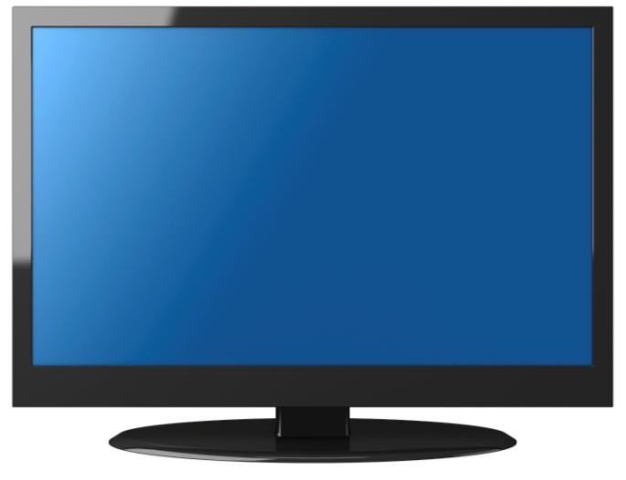
Media 5
Media influence
Media helps to improve the understanding of sport, popularizes sporting personalities and provides sports’ entertainment.

Slide 7
Media 7
By broadcasting sport in a variety of ways, the media may help to influence people to pursue an activity.
By employing a series of experts (past players, pundits, presenters and journalists), they can give their professional judgement, opinion and views on the sport in question.

Slide 8
Media 8
Types of television broadcast
Terrestrial
Although terrestrial television offers free channels, you must have a television licence to watch them.
http://www.youtube.com/watch?v=gMQZCP2Jwhg

Slide 9
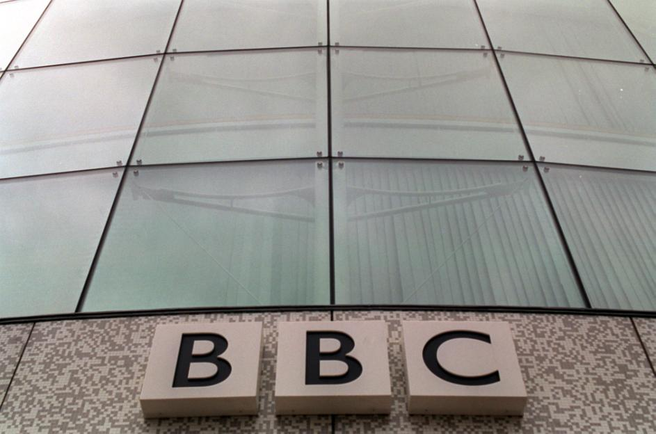
Media 9
The licence fee funds the BBC whilst advertisers pay for advertising space on all other channels.

Slide 10
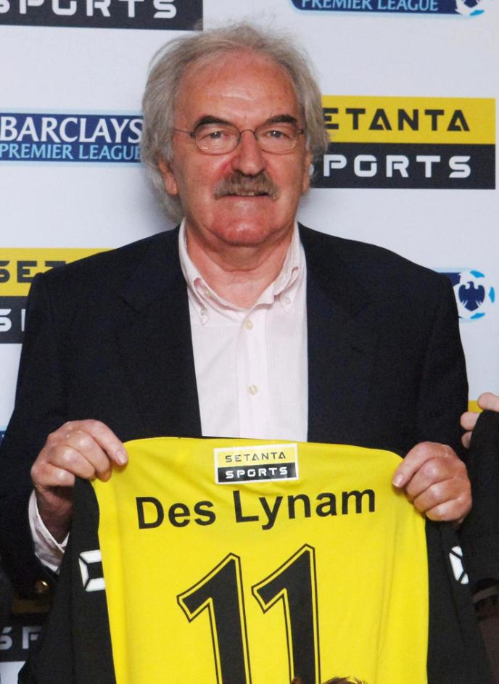
Media 10
Cable and satellite
Viewers of cable and satellite channels are charged for what they watch.
http://www.youtube.com/watch?v=aodh09ptgMk

Slide 11
Media 11
Web casts
An increasing number of television and radio programmes are available online in
real time or available to download through podcasts or on-demand services such as Channel 4’s 4oD and BBC’s iPlayer.

Slide 12
Media 12
Competition between
terrestrial and satellite channels
The Independent Television Commission (ITC) organizes the allocation of transmission of sporting events, ensuring they do not all go to the wealthier satellite companies.
There is steep competition between channels to show sporting events.

Slide 13
Media 16
Positive effects of
terrestrial coverage
Viewers can be informed of new trends and current players.
Some sports have an improved quality of coverage.
The BBC licence fee helps to fund more channels and therefore extends sports coverage.

Slide 14
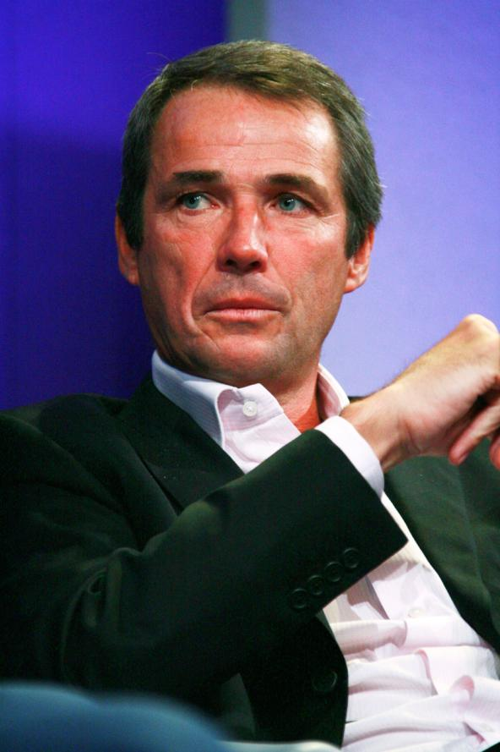
Media 17
Pundits can help increase people’s appreciation of sport through their professional opinion and experiences.
New events can be seen by everyone.

Slide 15
Media 18
New events can be seen by everyone.
More coverage enhances the development of sport.
Seeing sport on television may encourage participation.

Slide 16
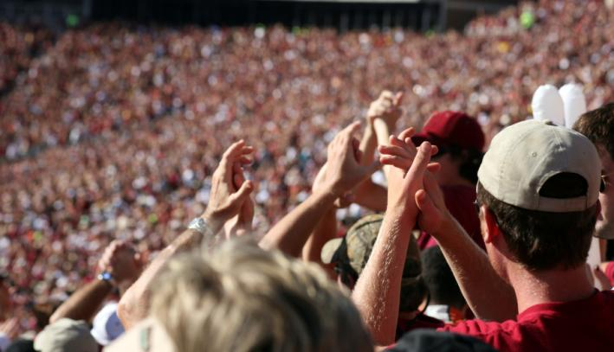
Media 19
The more sport is seen on television, the more supporters it might attract.
More coverage might make it easier to attract sponsors.

Slide 17
Media 20
People become familiar with sports personalities, who can become positive role models.
Money from broadcast bids goes directly to the sport.
Coverage of disabled sportspeople brings about an awareness of the needs of others and how sport can be undertaken by all.

Slide 18
Media 21
Positive effects of cable and satellite television coverage
Cable and satellite broadcasts have had a major influence on how people watch sport.
These services devote greater airtime to sport and a wider variety of events are available, but only to those who are willing to pay a monthly subscription.

Slide 19
Media 22
Greater coverage of minority sports; for example, Sky’s Extreme Sports channel broadcasts an average of 18 minority sports per week.
Makes a wider variety of sports accessible.
Helps increase the funding for sport.
Heightens the profile of sport, so can attract interest and sponsorship.

Slide 20
Media 23
There is an increased depth of coverage for major sports; some football clubs even have their own channel, such as Manchester United and Celtic FC.
Can encourage participation by stimulating interest and encouraging people to take part.
More live sport can be viewed.

Slide 21
Media 24
Task
Summarise the main points of what you have learnt about the media in relation to sport.

Slide 22
Media 26
What you have learnt
in this topic:
Types of media
Types of television broadcast
Competition between satellite and terrestrial television
The positives of satellite and terrestrial television

Slide 23
Media 27
Learning objectives
You should now be able to:
Understand the role of media in sport
Describe the different types of media and their influence on sport
Explain the differences between satellite and terrestrial television

Slide 24
Homework
Post a motivational sporting video, article or radio broadcast on Edmodo and explain what impact this has on you.
Download the Edmodo app.
Due: Wednesday 25th September.

